Slide 1
Pump it Up: Data Mining the Water Table
A Classification Project
Andrew Rowan, Flatiron School

Slide 2

Problem Statement
There are over 56,000 water pumps in Tanzania and the challenge is to create a model that can accurately classify them into the one of the following:
Functional
Non Functional
Functional needs repair
Why?
Save on money, time and labor.
Ensure potable water is being provided to as many communities as possible
Fig. 1: Water Pump in Uwiro Village, Tanzania (credit Tom Murphy)

Slide 3
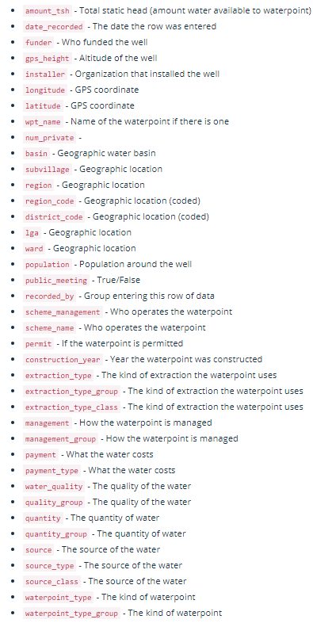
Data & Methods
Final Model
Logistic Regression
K-nearest neighbors
XGBoost
Decision Tree
Random Forest
Model evaluation, tuning and validation
Cleaning & Feature Engineering

Slide 4
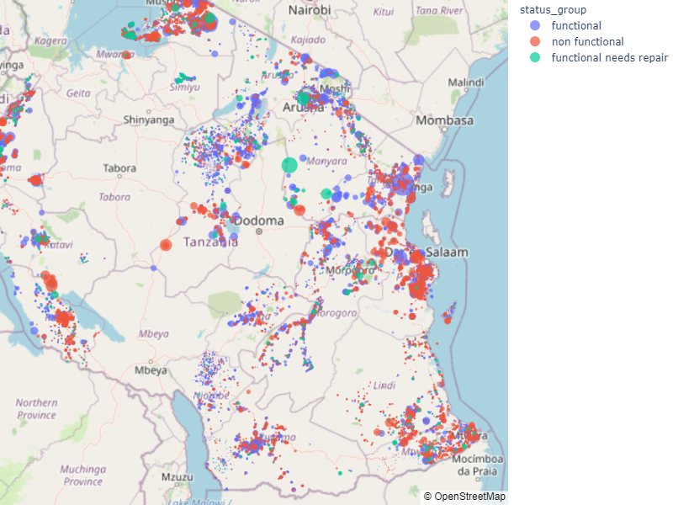
Tanzania Water Pumps
Relatively good spread on data.
Some regions with higher concentration of non-functional pumps.
Clearly location can matter…
Fig. 2: Water Pumps in Tanzania

Slide 5
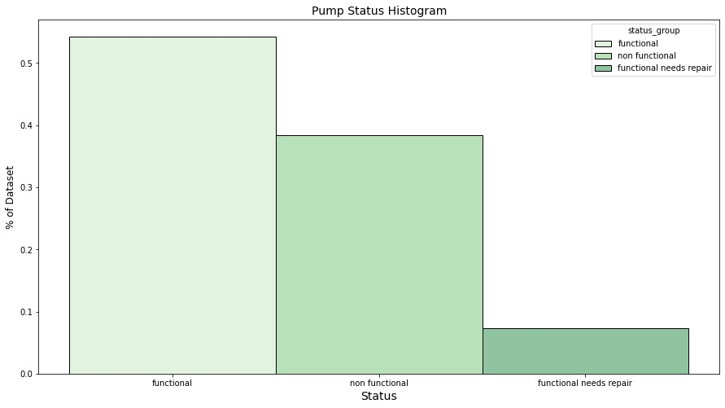
Class Imbalance

Slide 6
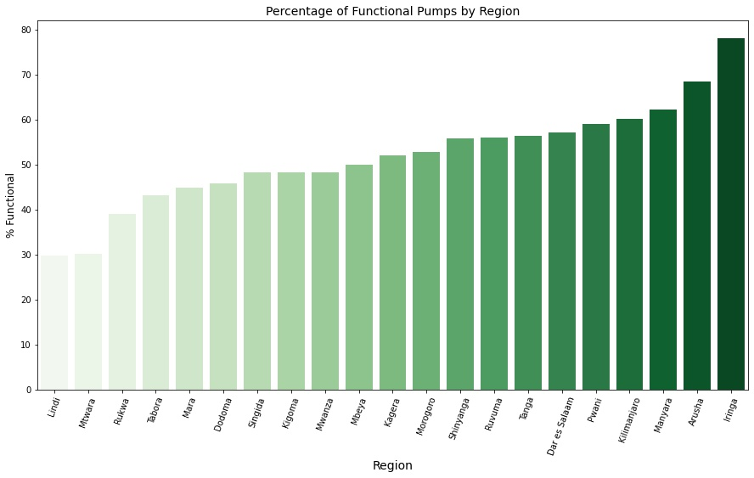
Functionality by Region

Slide 7
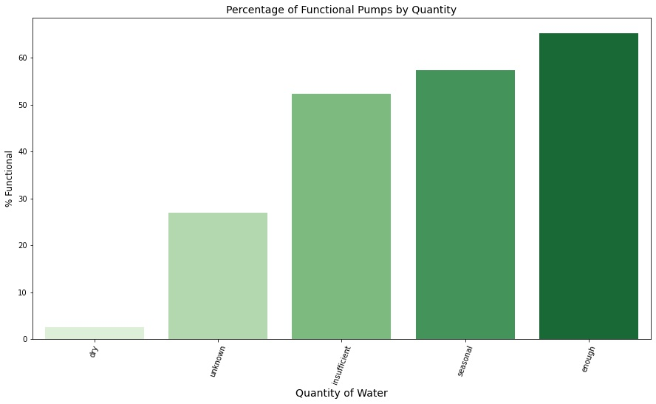
Functionality by Quantity of Water

Slide 8
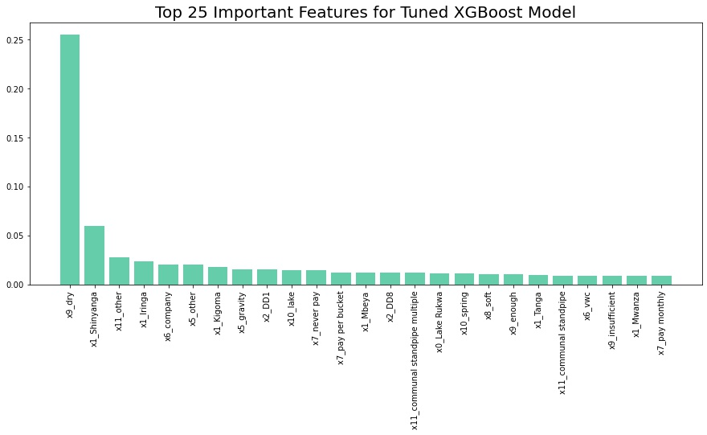
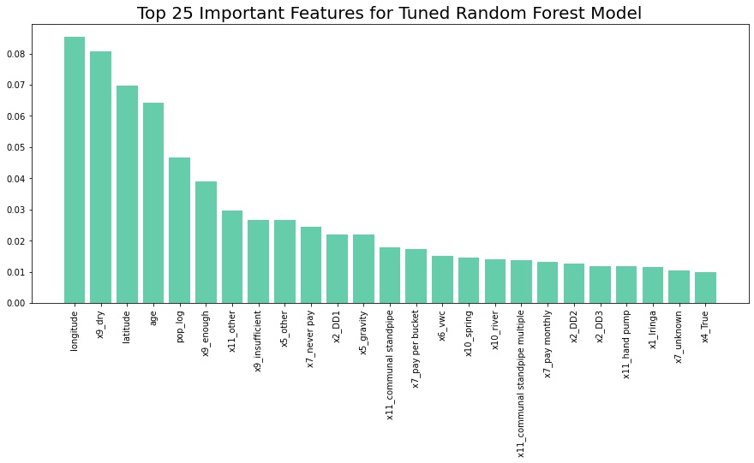
Feature Importance
On the two best performing models, an important feature was quantity, and in particular when one hot encoded X9_dry. Random Forest appears to have more intuitive importances: age, location, population.

Slide 9
Results -
XGBoost Tuned Model has best overall accuracy
Accuracy 0.7748
Recall 0.7875
Random Forest also performed well, with perhaps less overfitting and more interpretable / understandable importances.
Accuracy 0.7583
Recall 0.7561

Slide 10
Recommendations
The model still mis-classifies some pumps so for this reason:
Recommended to survey some ‘functional’ pumps in all site visits to capture errors
Population data was poor, it may be worth trying to extract this information from another source
Prioritise maintenance schedule to target areas with fewest working pumps per capita i.e need reliable population data.

Slide 11
Future Improvements
Make use of high cardinality features somehow – perhaps binning.
Utilise cloud computing to expand the parameters of RandomizedsearchCV
Source external data, rainfall data, maintenance records for new features
Are dry pumps really not functional? This may not improve the model but understanding this could help maintenance prioritisation.

Slide 12
Thank You!
Email: adrowan88@gmail.com

